Slide 1
Graduate Writing Forums
Overview
April 17, 2014
Vincenzo Coia
with Andy Leung

Slide 2
The Setup
Step 1
Step 2
Step 3
Forum Branch
Brainstorming Session
Online Sign-up
Forum Branch
...

Slide 3
Brainstorming Session
Forum Branch
Online
Sign-up
Forum Branch
...
You give answers to this question:
ALL struggles are accepted!
What are your struggles with technical writing?

Slide 4
Brainstorming Session
Forum Branch
Online
Sign-up
Forum Branch
...
Category 1
!
!
!
!
!
What are your struggles with technical writing?
!
!
!
!
!
!
Category 3
Category 2

Slide 5
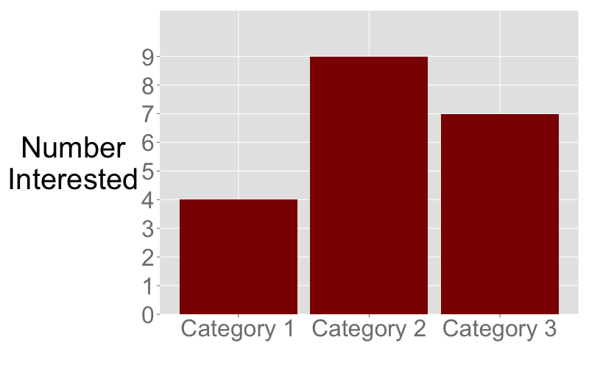
Brainstorming Session
Forum Branch
Online
Sign-up
Forum Branch
...
Gage interest (not the same as signing up!)
Select final categories (≥1, but not many)

Slide 6
Online
Sign-up
Forum Branch
Brainstorming Session
Forum Branch
...
Survey circulated to determine groups:
Which forum(s) will you commit to?
Category 2
Yes
No
Category 3
Yes
No
Forum Branch
Forum Branch

Slide 7
Forum Branch
Brainstorming Session
Online
Sign-up
Forum Branch
Small Group Meeting
Choose a group representative
Choose potential professors to lead workshop
Specify difficulties to present to instructor

Slide 8
Forum Branch
Brainstorming Session
Online
Sign-up
Forum Branch
Rep contacts professor
Implement advice
Submit to group for feedback
Small Group Meeting
Workshop lead by Faculty
Feedback Session
Everyone gives and receives feedback once.
Group rep records things learned/“minutes”.

Slide 9
Forum Branch
Brainstorming Session
Online
Sign-up
Forum Branch
Rep contacts professor
Implement advice
Submit to group for feedback
Small Group Meeting
Workshop lead by Faculty
Feedback Session
Implement advice

Slide 10
Group Rep Duties
Contact Professor:
Ask to lead workshop
Give outline of difficulties
They’re already willing to help!
Schedule/organize workshop and feedback session
Write brief “minutes” of feedback session.

Slide 11
That’s All! Summary:
Any thoughts? Suggestions? Concerns?
Forum Branch
Brainstorming Session
Online Sign-up
...
Forum Branch
Rep contacts professor
Implement advice
Implement advice
Small Group Meeting
Workshop lead by Faculty
Feedback Session
Submit to group for feedback

